Slide 1

Oedipa’s Revelatory Journey through America in The Crying of Lot 49
GROUP H

Slide 2

Who is Oedipa Maas?
Young Republican
Drunk at Tupperware Party during the day
California Suburbia (Kinneret-Among-The-Pines)
Image of a “mid-century bourgeois domestic [housewife with] no real role in her culture and way too much time on her hands.”
(Diana Blaine, “Death and The Crying of Lot 49,” quoted in J. Kerry Grant, A Companion to The Crying of Lot 49, 2nd ed. (Athens, GA: University of Georgia Press), 6)

Slide 3
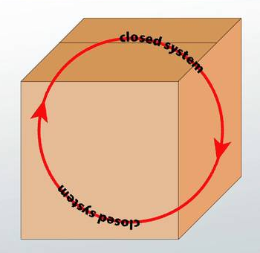
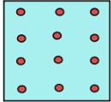


Closed System
Closed System
Stagnation
In need of Revitalization
Notes:
The Closed system “disseminates” within itself, starting out with energy and slowly degrading to a point of stagnation.
Note how the image of stagnation is used throughout the book in the “stillness” of water (such as at the pool).
This simultaneously could be read as an allusion to the story of Narcissus and Echo.
Being in a state of stagnation by her suburban lifestyle, Oedipa is in need of revitalizing it.

Slide 4

Theory of Miracle / Revelation
“You know what a miracle is. […] [It is ] another world’s intrusion into this one. Most of the time we coexist peacefully, but when we do touch there’s cataclysm.”
-Jesús Arrabal
Notes:
Miracle and Revelation as synonymous
Does not necessarily need to be read spiritually but relies on the emphasis of intrusion another world.
Jesús Arrabal: Playing off references to Jesus Christ, the Christian Savior, and Arrabal, literally translated to “the regions on the outskirts of a city.”
Jesús Arrabal represents closed system revitalization (or salvation) via the marginalized “Other.”
At the same time, Oedipa begins to see his reliance upon Pierce for “outside” revitalization. In some sense, this helps her understand her own reliance upon the Tristero, or “Other” America for her own revitalization.

Slide 5
Notes:
The Tristero is the catalyst that allows Oedipa’s world to be intruded by another.

Slide 6

“Other” America
“exhausted busful of Negroes going on to graveyard shifts all over the city.” (91)
“facially-deformed welder, who cherished his ugliness.” (93)
W.A.S.T.E
Encounter with Sailor suffering from DT (Delirium Tremens)
Notes:
Images of “Other” America seen by Oedipa during her night out walking.
DT → Delirium tremens (DTs) is a rapid onset of confusion usually caused by withdrawal from alcohol. When it occurs, it is often three days into the withdrawal symptoms and lasts for two to three days. Physical effects may include shaking, shivering, irregular heart rate, and sweating. People may also hallucinate. Occasionally, a very high body temperature or seizures (colloquially known as "rum fits")^{[5][6]} may result in death.^{[2]} Alcohol is one of the most dangerous drugs to withdraw from. (Wikipedia)

Slide 7

Notes:
Her encounters with “hidden” people and groups, marked by their marginalization from the mainstream, act revelatory and complicate her view of society, class, and the city.
This eventually leads Oedipa to understand Pierce’s legacy (once perceived uniquely) to be something synonymous with the condition of America itself: the “prevailing winds of affluence” that cause the “storm-systems of group suffering and need” across the country (135)

Slide 8
Question:
How does Oedipa’s new perceptions of America tangibly benefit the marginalized she has “used” to revitalize her own “system”?

Slide 9
Answer:
During the miraculous instance of intrusion of her world by the Sailor’s world, we are importantly given an image of Oedipa actively participating in W.A.S.T.E on the Sailors’ behalf – it is she who drops the mail off in the bin for him (98). In essence, Oedipa is no longer simply learning from “Other” America but participating in it. This form of praxis-oriented revolt is what is needed if “system revitalization” is to be understood non-exploitatively.
Follow up: Do you think this is genuine? Or does she put it in the bin simply to learn more about Tristero?

